Slide 1
Unit 14 Transformers
Part C: Transformer Current Ratio and Power

Slide 2
What will you learn?
Relationship between turns ratio and input-output current ratio of a transformer.
Phase dot notation for transformers.
Input-output power relationship of a lossless transformer.

Slide 3
Recapitulation: Transformer Turns Ratio, n
Step-up transformer: n > 1
Step-down transformer: n < 1
Notes:
08/22/99
2

Slide 4
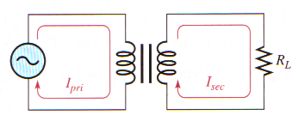
Loading the Secondary Winding
When a load resistor is connected to the secondary winding, a current flows through the secondary circuit because of the voltage induced in the secondary winding.
The ratio of the primary current, I_{pri}, to the secondary current, I_{sec} is equal to the turns ratio.

Slide 5
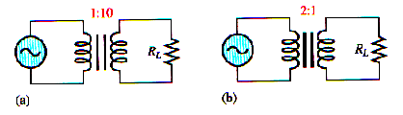
Example
With reference to Figure (a) and (b), calculate the secondary winding current if the primary current is 100 mA in each case.
Solution

Slide 6
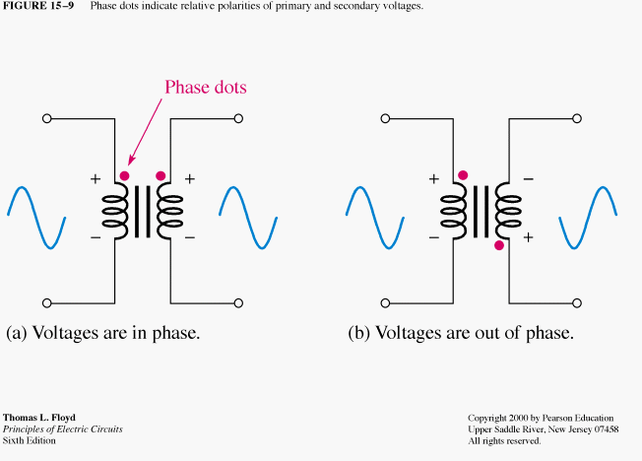
Direction of Windings
Another important transformer parameter is the direction in which the windings are placed around the core.
The direction of the windings determines the polarity of the voltage across the secondary winding (secondary voltage) with respect to the voltage across the primary winding (primary voltage).
Phase dots are used on the schematic symbols to indicate the voltage polarities.

Slide 7
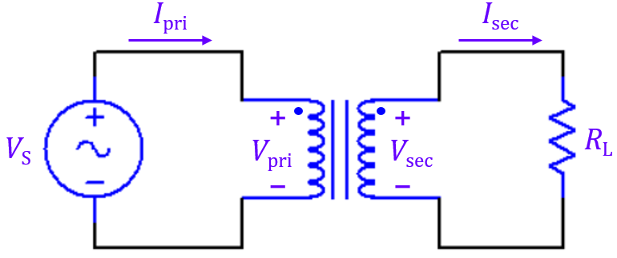
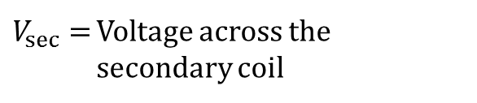
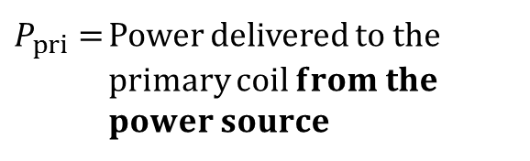
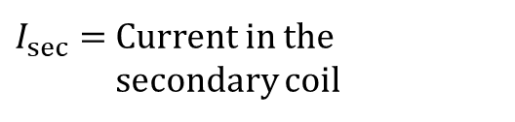

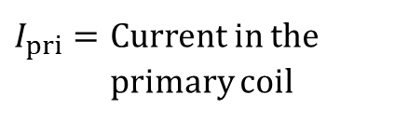

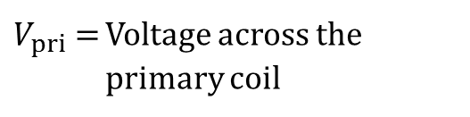

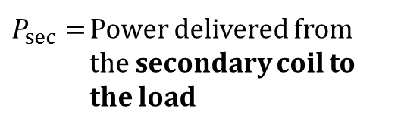
Power in a Transformer
For an ideal transformer, the power delivered to the primary coil equals the power delivered from the secondary coil to the load.
$$P_{pri}=P_{sec}$$
where
$P_{pri}=$ Power delivered to the primary coil 𝐟𝐫𝐨𝐦 𝐭𝐡𝐞 𝐩𝐨𝐰𝐞𝐫 𝐬𝐨𝐮𝐫𝐜𝐞
$P_{sec}=$ Power delivered from the secondary coil to the load
$$P_{pri}=V_{pri}{ I}_{pri}$$
$V_{pri}=$ Voltage across the primary coil
$V_{sec}=$ Voltage across the secondary coil
$$P_{sec}=V_{sec}{ I}_{sec}$$
$I_{pri}=$ Current in the primary coil
$I_{sec}=$ Current in the secondary coil

Slide 8
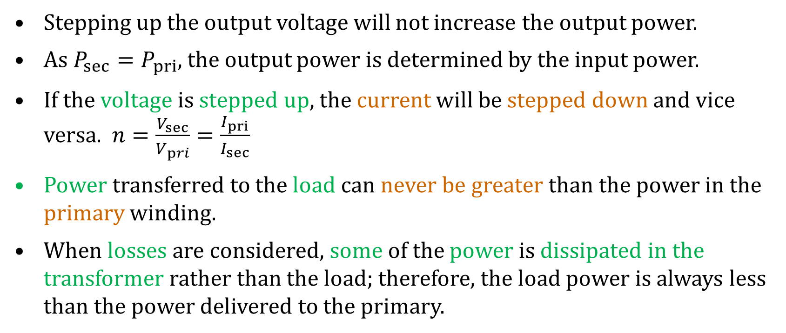
Power in a Transformer
Stepping up the output voltage will not increase the output power.
As $P_{sec}=P_{pri}$, the output power is determined by the input power.
If the voltage is stepped up, the current will be stepped down and vice versa. $n=\frac{V_{sec}}{V_{pri}}=\frac{I_{pri}}{I_{sec}}$
Power transferred to the load can never be greater than the power in the primary winding.
When losses are considered, some of the power is dissipated in the transformer rather than the load; therefore, the load power is always less than the power delivered to the primary.

Slide 9
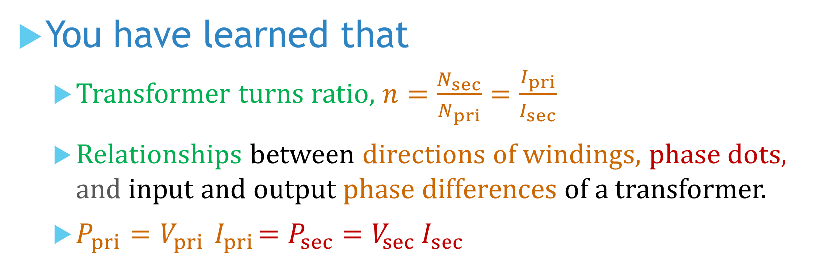
You have learned that
Transformer turns ratio, $n=\frac{N_{sec}}{N_{pri}}=\frac{I_{pri}}{I_{sec}}$
Relationships between directions of windings, phase dots, and input and output phase differences of a transformer.
$P_{pri}=V_{pri}{ I}_{pri}=P_{sec}=V_{sec}{ I}_{sec}$

Slide 10
Coming Up Next
This is the end of this whole module.

